Slide 1
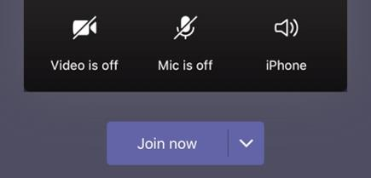
Welcome to Phonics!

Make sure you have your pencil and paper ready for when you need them.
Cameras and Microphones off until we say!

Slide 2
Let’s practise some of the sounds we already know…

Slide 3
o
z
w
i
qu
y
e
j
ck
d
r
h
x
b

Slide 4
My turn…
Your turn…
o
z
w
i
qu
y
e
j
ck
d
r
h
x
b

Slide 5
Let’s have a go at reading these words…
van
ring
quack
jump
bed
cup

Use your robot arms and blending hands!
Tell your grown up the answer…

Slide 6
This time we will try to read them fluently!
quack
van
ring
jump
cup
bed

Don’t use any arms or hands to help you.
Use your eyes to read the words without sounding them out!

Slide 7
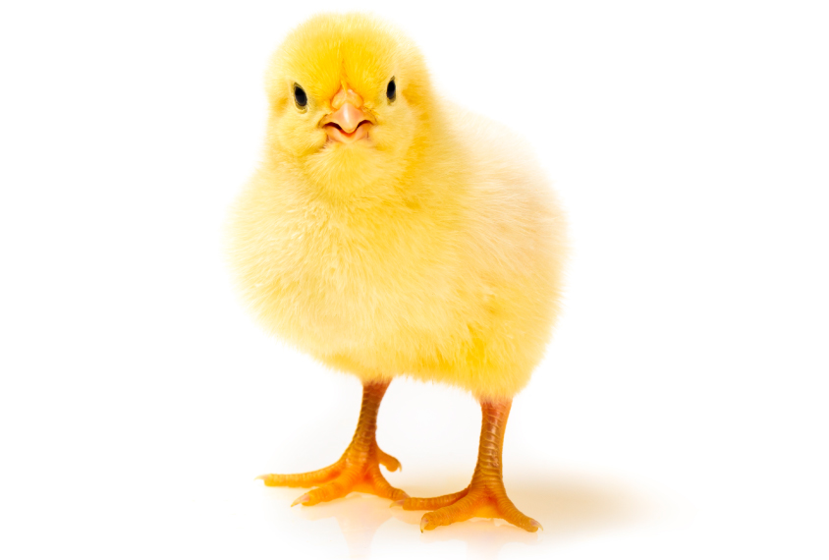
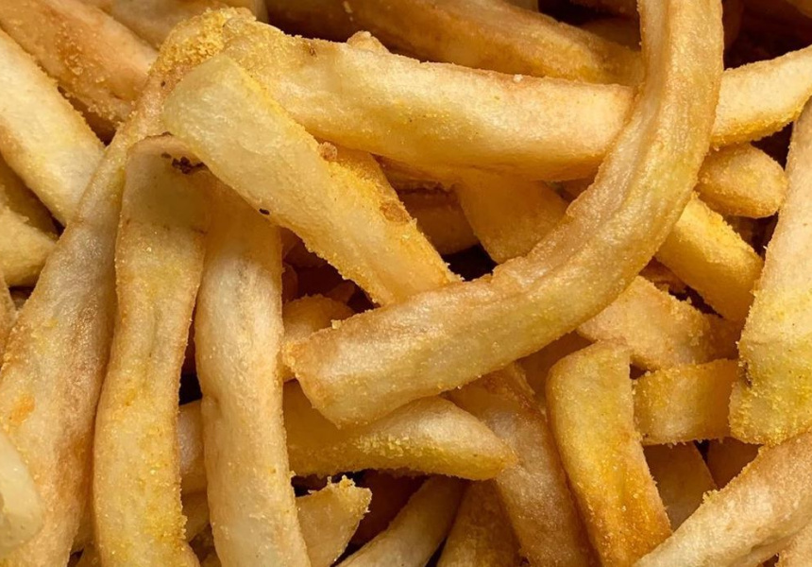
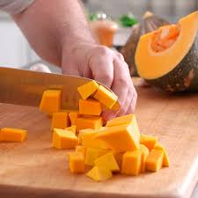


Sound talking!

Slide 8
Today’s new sound is:
ch

Slide 9
Have a go at writing the new sound:
ch

Slide 10
ch words…
p
ch
i
You can use your robot arms and blending hands again to help you read these new words!

Slide 11
o
ch
p
You can use your robot arms and blending hands again to help you read these new words!

Slide 12
a
ch
t
You can use your robot arms and blending hands again to help you read these new words!

Slide 13
i
ch
ck
You can use your robot arms and blending hands again to help you read these new words!

Slide 14
ch
n
i
You can use your robot arms and blending hands again to help you read these new words!

Slide 15
ch words…
chop
chick
chin
chip
chat

We have seen these words before, so have a go at reading them without the help of robot arms and blending hands!

Slide 16
Find the ch words!

jam
chop
chip
mitten
chat
chin
bat
mop
bed
rocket
chick

Slide 17
Let’s have a go at writing some of the new words we have learnt to read!

Slide 19
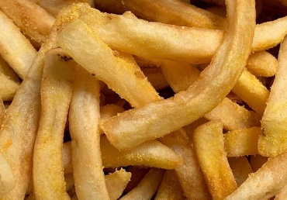

Slide 20
Tricky words!
Lets read some tricky words you already know!
to
into
the
no
go
I

Slide 21
The new tricky word is…
he
Who can tell me a sentence with the word he in it?

Slide 22
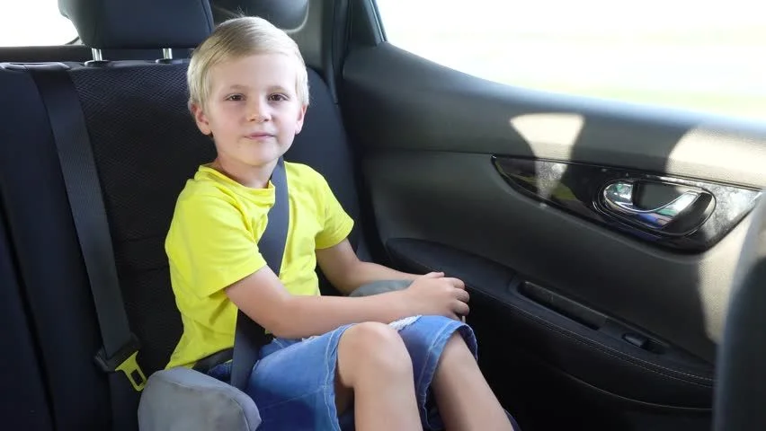
My turn first…
He went to school in the car.

Slide 23
Your turn!


Slide 24
Your turn to write the word he…

Slide 25
Let’s have a go at reading sentences!
I sat on the mat.

Slide 26
Let’s have a go at reading sentences!
I chop teh chip up.

Slide 27
Let’s have a go at reading sentences!
I chop the chip up.

Slide 28
Let’s have a go at reading sentences!
The ipch is big.

Slide 29
Let’s have a go at reading sentences!
The chip is big.

Slide 30
More information…
More handwriting fun can be found using the Letter join app – log in details are on our school website!
These lessons are recorded and I will post them onto YouTube for your child to re-watch if they need to.

