Slide 1
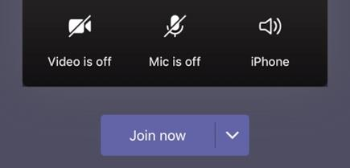
Welcome to Phonics!

Make sure you have your pencil and paper ready for when you need them.
Cameras and Microphones off until we say!

Slide 2
Let’s practise some of the sounds we already know…

Slide 3
o
z
w
i
qu
ch
y
e
j
ck
d
r
h
x
b

Slide 4
My turn…
Your turn…
o
z
w
i
qu
ch
y
e
j
ck
d
r
h
x
b

Slide 5
Let’s have a go at reading these words…
quack
socks
pen
run
fit
tip

Use your robot arms and blending hands!
Tell your grown up the answer…

Slide 6
This time we will try to read the words fluently…
quack
socks
pen
run
fit
tip

Remember fluently means with no robot arms and blending hands. Use just your eyes to read the words.

Slide 7
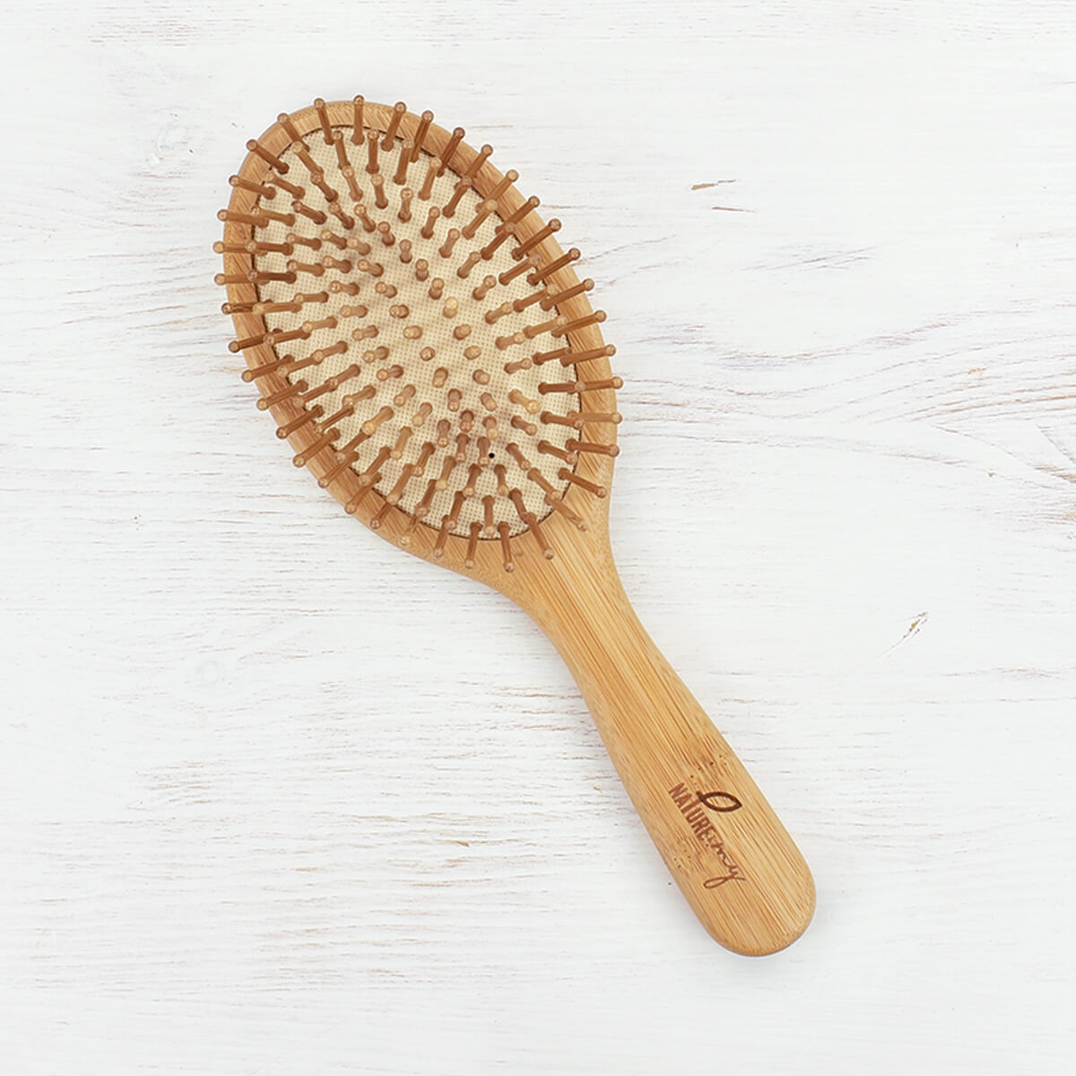
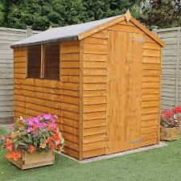


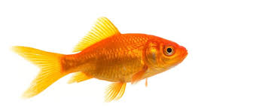
Sound talking!

Slide 8
Today’s new sound is:
sh

Slide 9
Have a go at writing the new sound:
sh

Slide 10
sh words…
p
sh
i
You can use your robot arms and blending hands again to help you read these new words!

Slide 11
o
sh
p
You can use your robot arms and blending hands again to help you read these new words!

Slide 12
f
sh
i
You can use your robot arms and blending hands again to help you read these new words!

Slide 13
e
sh
d
You can use your robot arms and blending hands again to help you read these new words!

Slide 14
br
sh
u
You can use your robot arms and blending hands again to help you read these new words!

Slide 15
sh words…
ship
fish
shop
brush
shed

We have seen these words before, so have a go at reading them without the help of robot arms and blending hands!

Slide 16
Find the sh words!

laptop
chop
ship
cash
duck
shed
brush
chop
bed
fish
chick

Slide 17
Let’s have a go at writing some of the new words we have learnt to read!

Slide 18


Slide 20
Tricky words!
Lets read some tricky words you already know!
to
he
into
the
no
go
I

Slide 21
The new tricky word is…
she
Who can tell me a sentence with the word he in it?

Slide 22
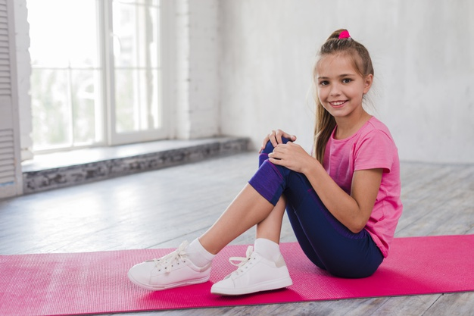
My turn first…
She sat on the mat.

Slide 23
Your turn!


Slide 24
Your turn to write the word she…

Slide 25
Let’s have a go at reading sentences!
I went into the shop.

Slide 26
Let’s have a go at reading sentences!
I got a shif from the shop.

Slide 27
Let’s have a go at reading sentences!
I got a fish from the shop.

Slide 28
What word could we put in the gap?
The ship is ______.


Slide 29
The ship is floating.
The ship is on the water.
The ship is red.

Slide 30
More information…
More handwriting fun can be found using the Letter join app – log in details are on our school website!
These lessons are recorded and I will post them onto YouTube for your child to re-watch if they need to.

