Slide 1
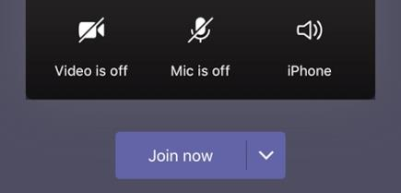
Welcome to Phonics!

Make sure you have your pencil and paper ready for when you need them.
Cameras and Microphones off until we say!

Slide 2
Let’s practise some of the sounds we already know…

Slide 3
f
ck
ch
o
z
w
i
y
qu
j
d
r
h
x
b
sh

Slide 4
My turn…
Your turn…
f
ck
ch
o
z
w
i
y
qu
j
d
r
h
x
b
sh

Slide 5
Let’s have a go at reading these words…
quack
brush
pen
run
fit
chip

Use your robot arms and blending hands!
Tell your grown up the answer…

Slide 6
This time we will try to read the words fluently…
quack
brush
pen
run
fit
chip

Remember fluently means with no robot arms and blending hands. Use just your eyes to read the words.

Slide 7
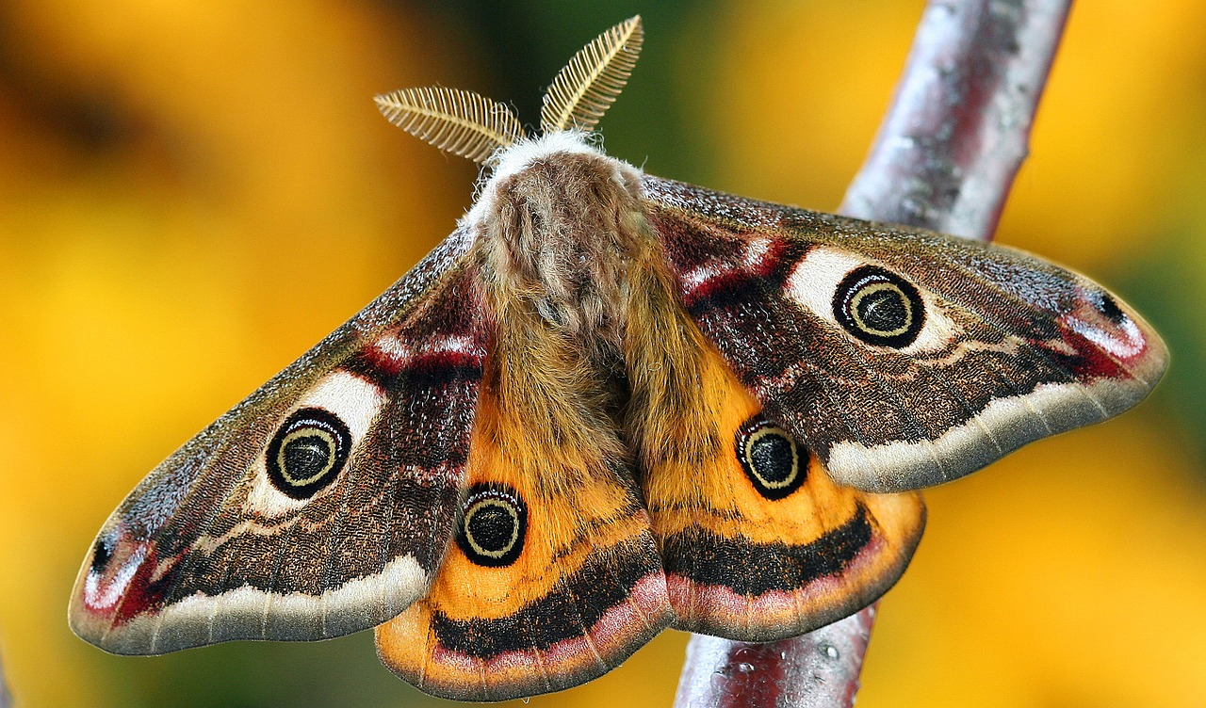

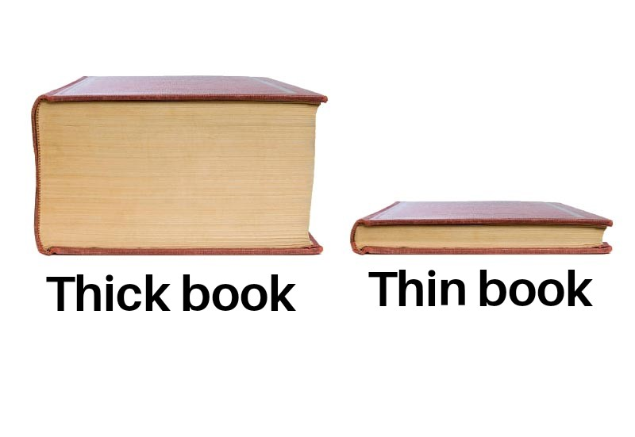
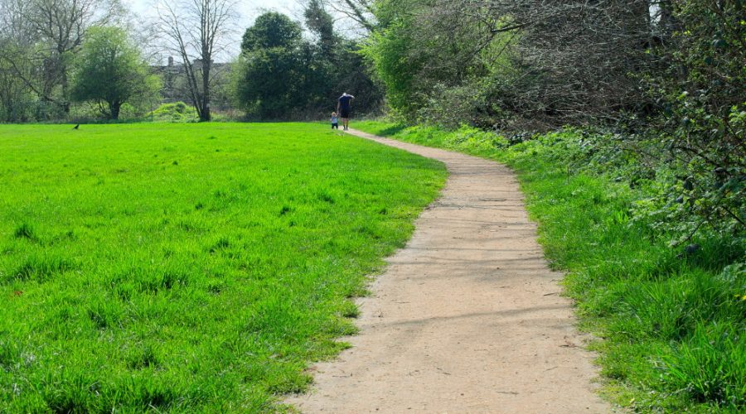
Sound talking!

Slide 8
Today’s new sound is:
th

Slide 9
Have a go at writing the new sound:
th

Slide 10
th words…
b
th
a
You can use your robot arms and blending hands again to help you read these new words!

Slide 11
th
ck
i
You can use your robot arms and blending hands again to help you read these new words!

Slide 12
th
n
i
You can use your robot arms and blending hands again to help you read these new words!

Slide 13
p
th
a
You can use your robot arms and blending hands again to help you read these new words!

Slide 14
m
th
o
You can use your robot arms and blending hands again to help you read these new words!

Slide 15
sh words…
ship
fish
shop
brush
shed

We have seen these words before, so have a go at reading them without the help of robot arms and blending hands!

Slide 16
Find the th words!

mitten
thick
ship
bath
moth
thin
chip
brush
bed
chop
fish
path

Slide 17
Let’s have a go at writing some of the new words we have learnt to read!

Slide 19
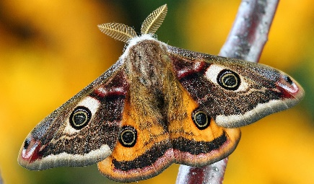

Slide 20
Tricky words!
Lets read some tricky words you already know!
to
into
the
no
go
I

Slide 21
Can anyone remember our 2 new tricky words this week?


Slide 22
he

Slide 23
she

Slide 24
Let’s have a go at reading sentences!
She is on the ship.

Slide 25
Let’s have a go at reading sentences!
Eh went to teh shop.

Slide 26
Let’s have a go at reading sentences!
He went to the shop.

Slide 27

Can you help me put this sentence in order?
got
bath.
I
in
the
I
got
in
the
bath.

Slide 28
More information…
More handwriting fun can be found using the Letter join app – log in details are on our school website!
These lessons are recorded and I will post them onto YouTube for your child to re-watch if they need to.

