Slide 1
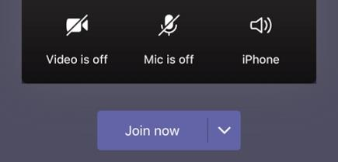
Welcome to Phonics!

Make sure you have your pencil and paper ready for when you need them.
Cameras and Microphones off until we say!

Slide 2
Let’s practise some of the sounds we already know…

Slide 3
f
ck
th
ch
o
sh
z
w
i
y
qu
j
d
r
h
x
b

Slide 4
a | sh | c | b | f
th | ck | o | v | j
y | m | ng | i | t
x | e | qu | s | h
g | z | b | w | ch

Slide 5
Let’s have a go at reading these words…
path
chat
brush
fix
shop
jet

Use your robot arms and blending hands!
Tell your grown up the answer…

Slide 6
This time we will try to read the words fluently…
chat
brush
path
fix
shop
jet

Remember fluently means with no robot arms and blending hands. Use just your eyes to read the words.

Slide 7

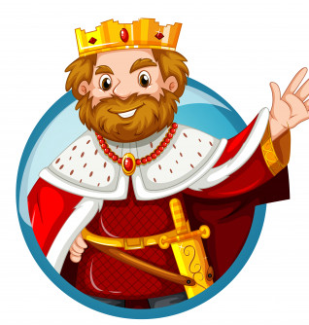

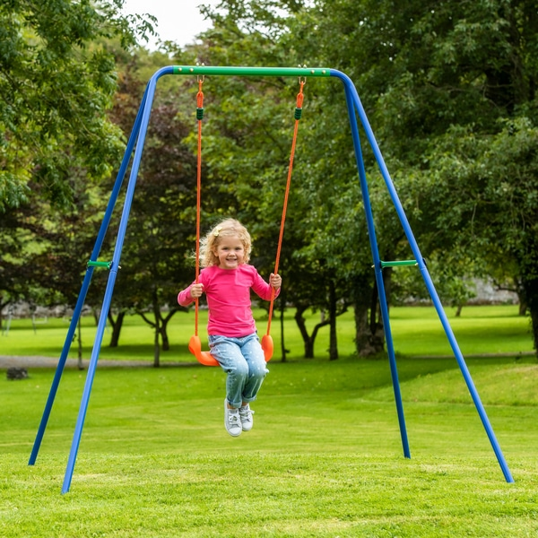

Sound talking!

Slide 8
Today’s new sound is:
ng

Slide 9
Have a go at writing the new sound:
ng

Slide 10
ng words…
r
ng
i
You can use your robot arms and blending hands again to help you read these new words!

Slide 11
s
ng
i
You can use your robot arms and blending hands again to help you read these new words!

Slide 12
l
ng
u
You can use your robot arms and blending hands again to help you read these new words!

Slide 13
k
ng
i
You can use your robot arms and blending hands again to help you read these new words!

Slide 14
sw
ng
i
You can use your robot arms and blending hands again to help you read these new words!

Slide 15
ng words…
hang
king
sing
swing
lung

Lets use our robot arms and blending hands to read these words – there are some new ones in there this time!

Slide 16
Find the ng words!

mitten
hang
lung
bath
moth
thin
sing
brush
bed
chop
ring
path

Slide 17
Let’s have a go at writing some of the new words we have learnt to read!

Slide 19



Slide 20
Tricky words!
Lets read some tricky words you already know!
to
into
the
no
go
I

Slide 21
Can anyone remember our 2 new tricky words this week?


Slide 22
he

Slide 23
she

Slide 24
Let’s play draw it!
Your job is to draw a picture of the words you are reading!
You have 30 seconds for each picture!

Slide 25

ring

Slide 26

grass

Slide 27

bath

Slide 28

chips

Slide 29
More information…
More handwriting fun can be found using the Letter join app – log in details are on our school website!
These lessons are recorded and I will post them onto YouTube for your child to re-watch if they need to.

