Slide 1
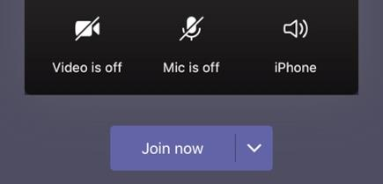
Welcome to Phonics!

Make sure you have your pencil and paper ready for when you need them.
Cameras and Microphones off until we say!

Slide 2
Let’s practise the sounds we have learnt this week!
Does anyone remember what they are?


Slide 3
sh
th
ch
ng

Slide 4
Let’s have a go at reading these familiar words…
chick
brush
ring
chop
long
chin
thing
ship
fish
lung

Remember fluently means with no robot arms and blending hands. Use just your eyes to read the words.

Slide 5
Can you have a go at writing these words with me?

Slide 6
Can you read and find the word?
thing
thick
ship
cash
duck
shed
long
thin
chop
fish
chick

Slide 7
Let’s have a go at writing a whole sentence together!

Slide 8
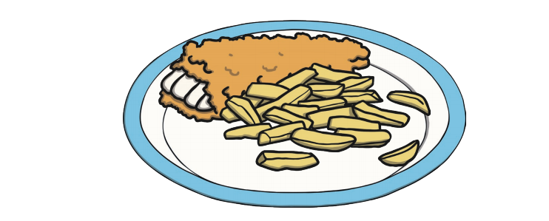

Slide 9
Tricky words!
Lets read some tricky words you already know!
to
he
into
the
no
go
I
she

Slide 10
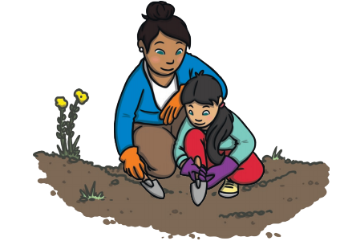
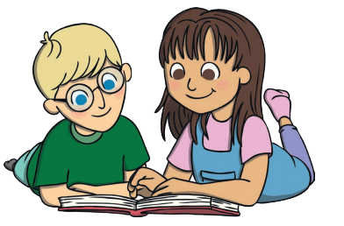
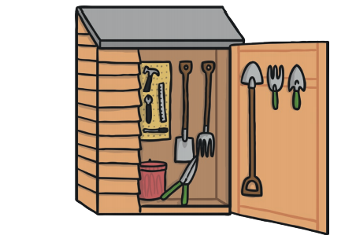
Match it!
I went into the shed.

Slide 11
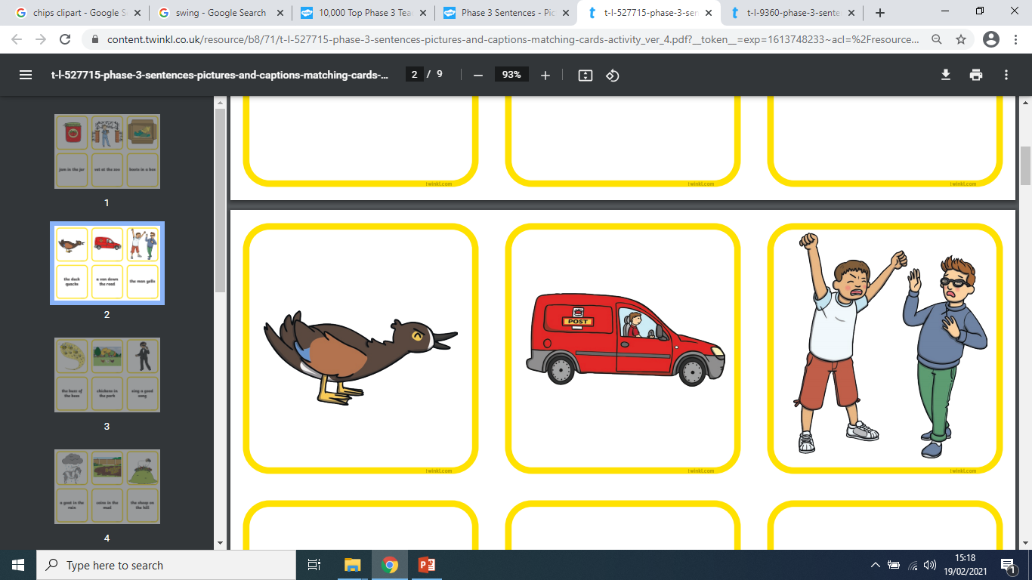
Match it!
The duck quacks.

Slide 12
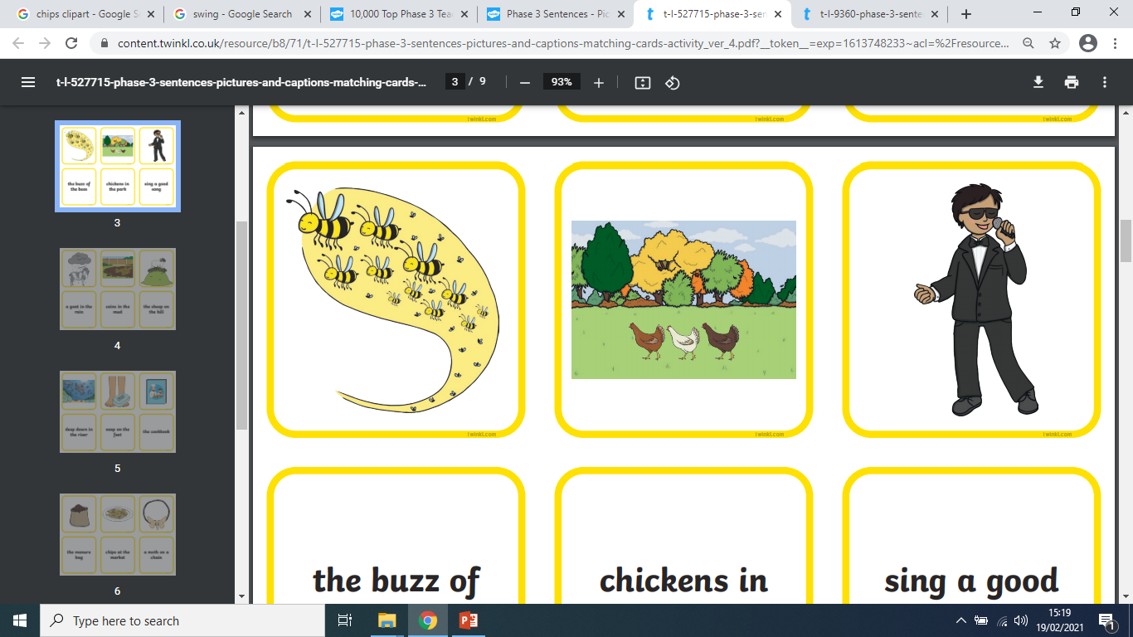
Match it!
I will sing a song.

Slide 13
Monday…
We will be playing Bingo, please have a 3x2 grid (below) prepared ready to play.
We will fill in the sounds/words on the day!

Slide 14
More information…
More handwriting fun can be found using the Letter join app – log in details are on our school website!
These lessons are recorded and I will post them onto YouTube for your child to re-watch if they need to.

