Slide 2
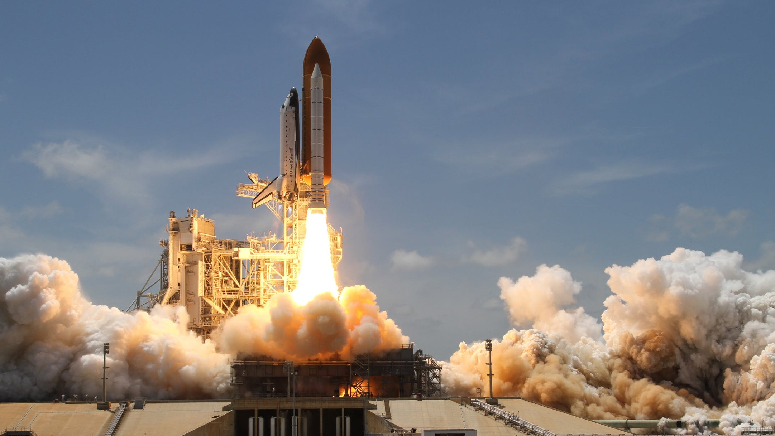
Shuttle Launch

Slide 3
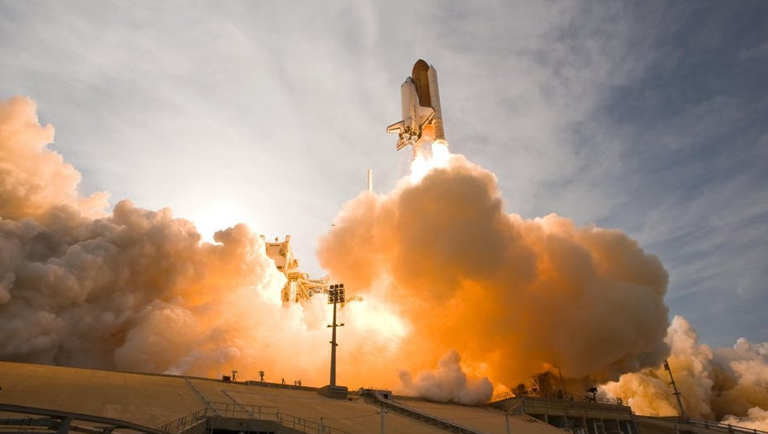
Space Shuttle

Slide 4

Spacecraft Landing

Slide 5
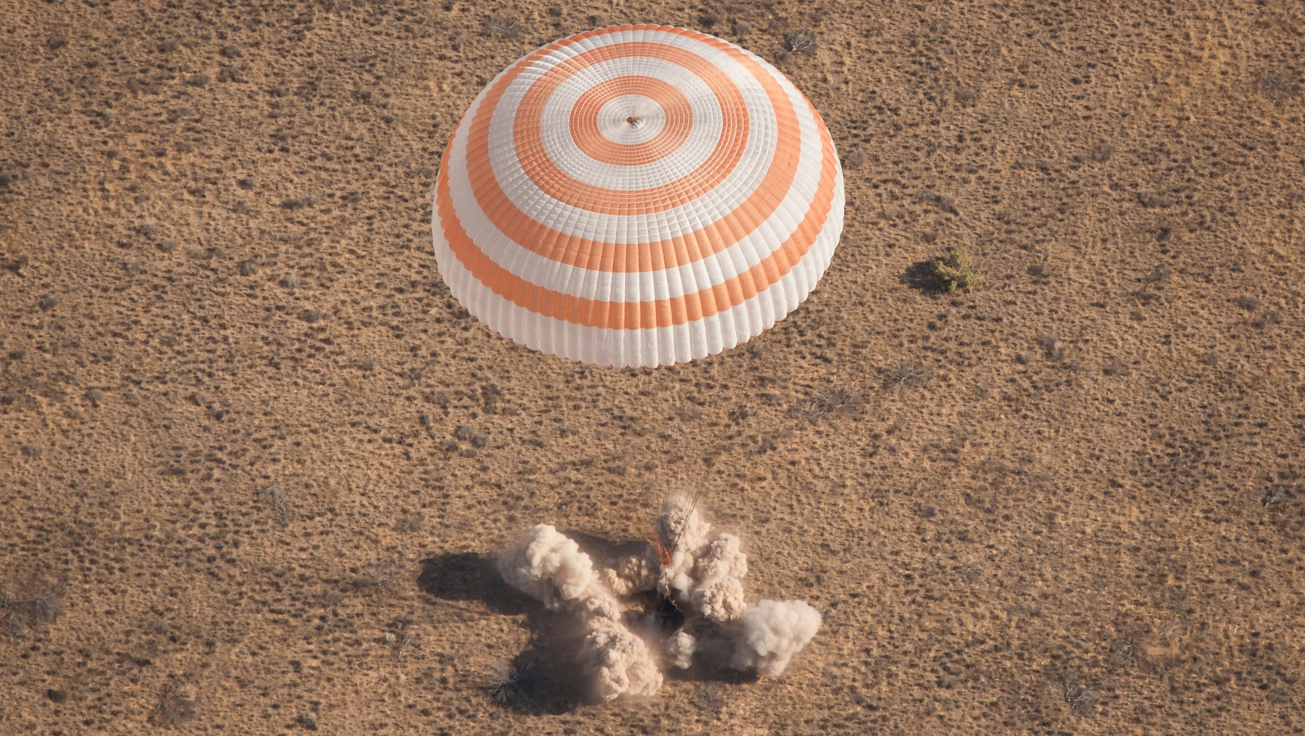
Spacecraft Landing

Slide 6
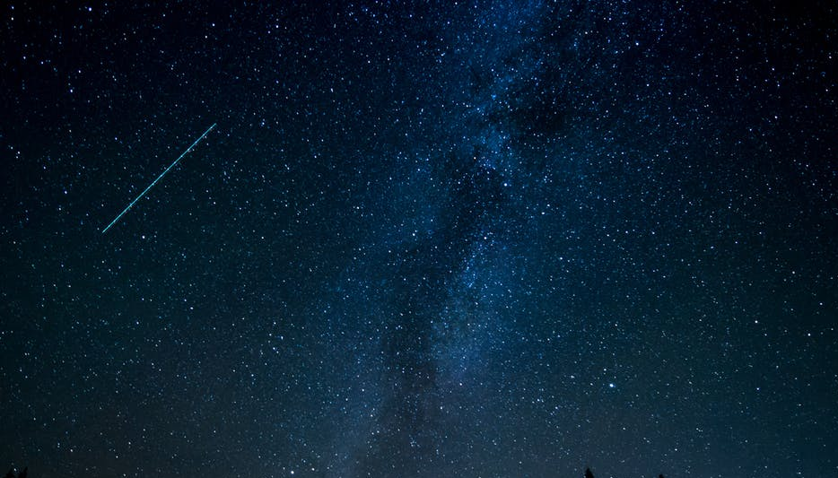
Comet

Slide 7
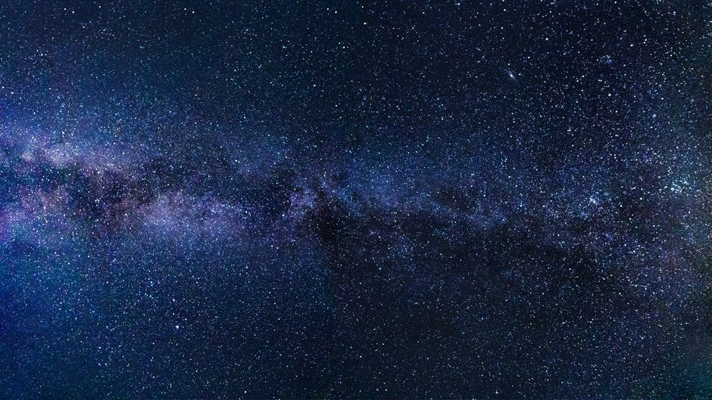
Stars

Slide 8
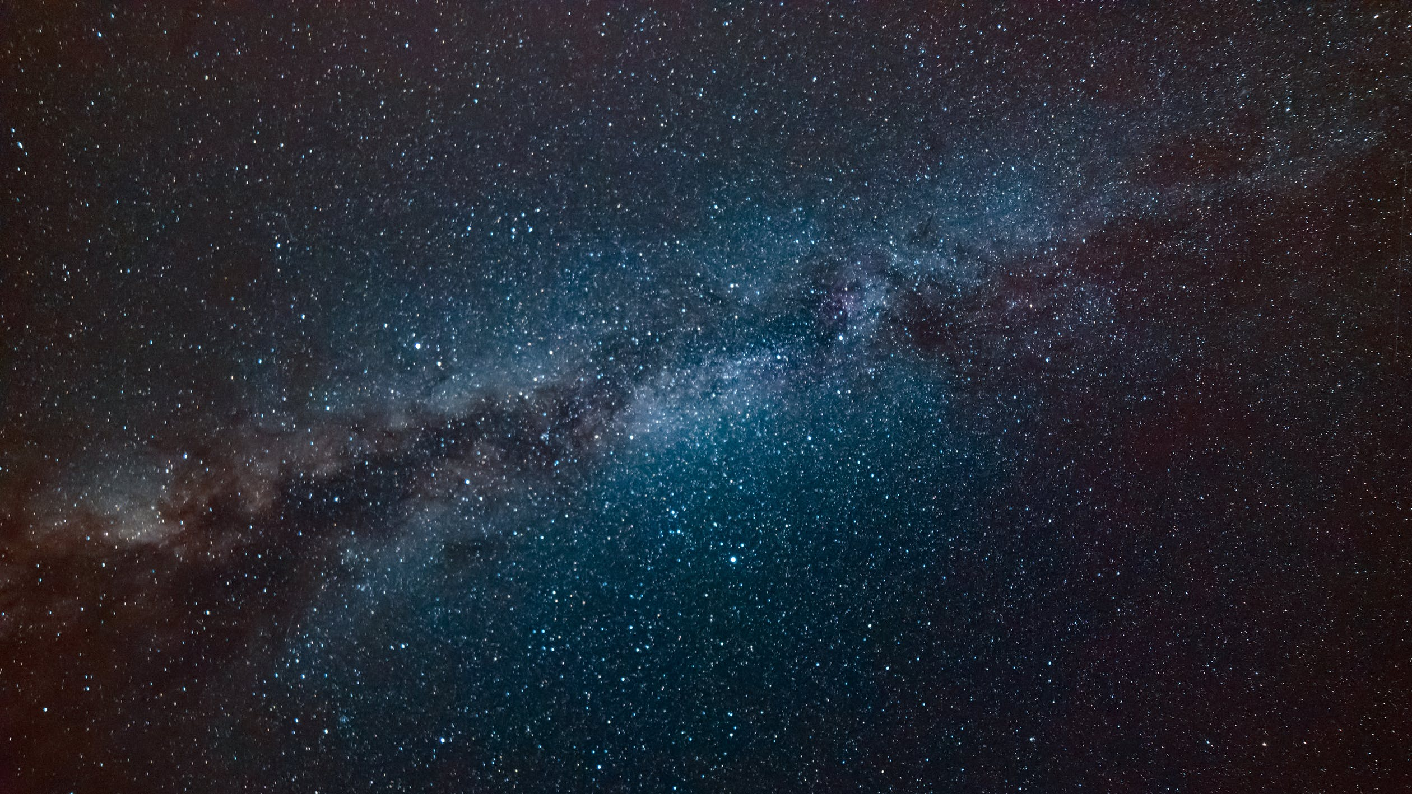
Galaxy

Slide 9
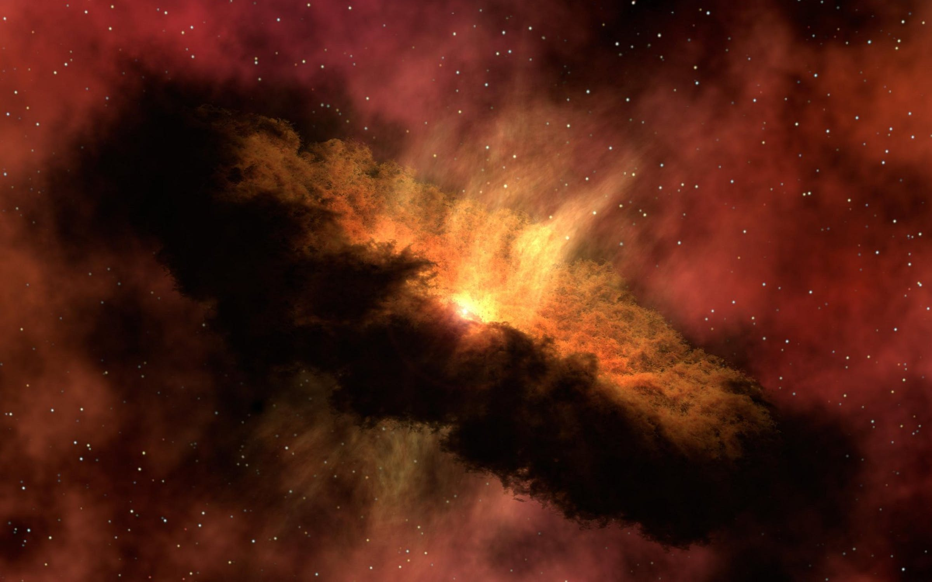
Nebula

Slide 10
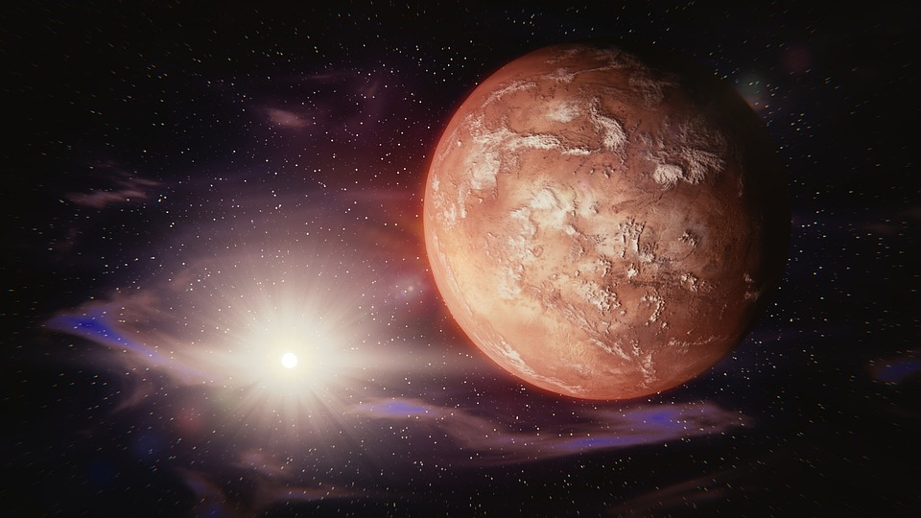
Mars

Slide 11
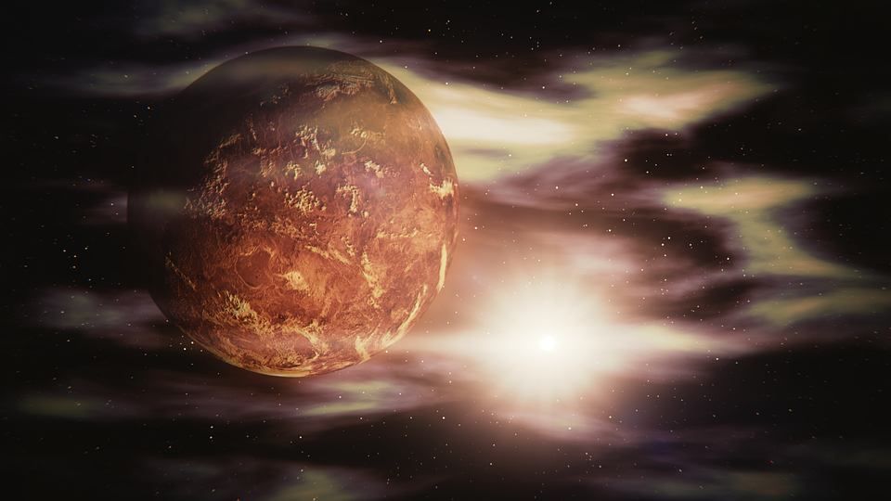
Venus

Slide 12
Jupiter

Slide 13
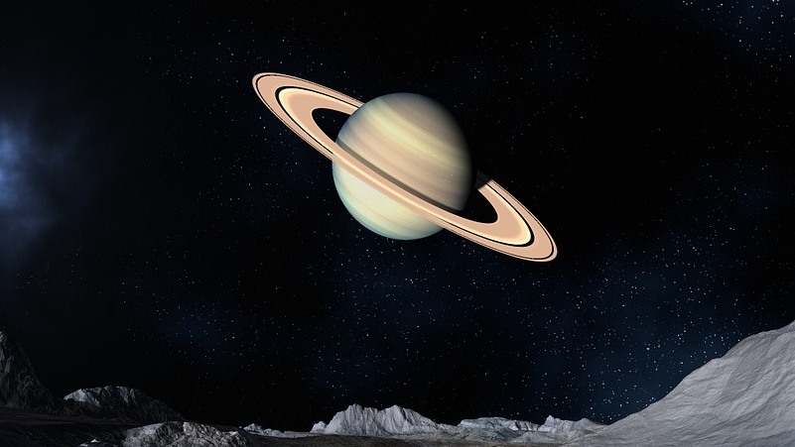
Saturn

Slide 14
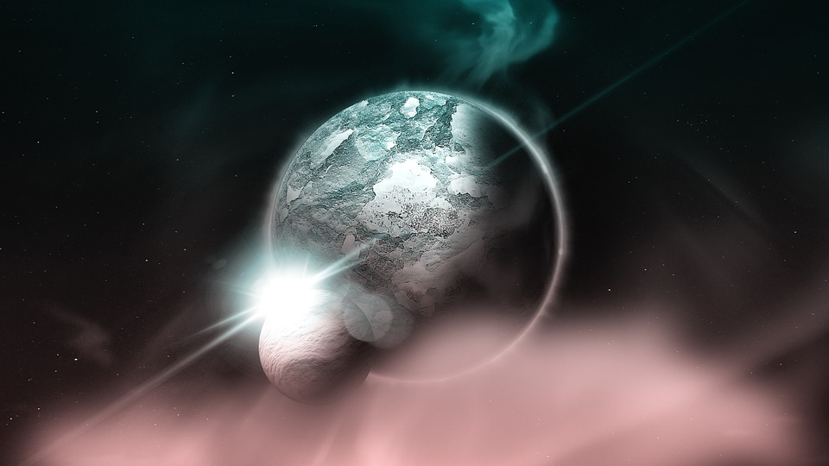
Pluto

