Slide 1
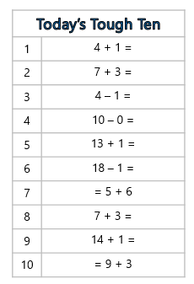
Tough Ten Row 1
You have 3 minutes to complete your Questions

