Slide 1
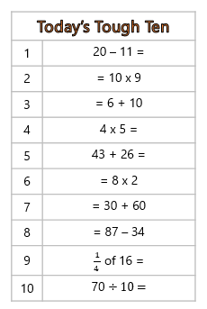
Tough Ten
You have 3 minutes to answer all of the questions.

