Slide 1
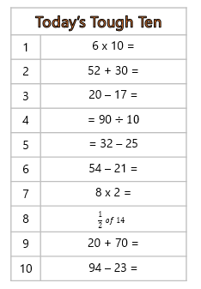
Tough Ten 13.7.21
You have 3 minutes to answer all of the questions.

