Slide 1
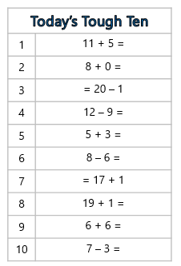
Tough Ten Row 1
14.7.21
You have 3 minutes to complete your Questions

